Slide 1
Machine Learning to Deep Learning_3
Tutorial code: https://github.com/leejaymin/TensorFlowLecture
2017. 02. 06
Jemin Lee (leejaymin@cnu.ac.kr)
Hompage: https://leejaymin.github.io/index.html
Notes:
역사
알고리즘 약간은 깊이 있는 이해
그것을 통한 실제 구현 과 응용
시스템 Area에서의 Deep-Learning

Slide 2
Table of Contents
Fundamental Machine Learning (1일차)
Linear Regression: Gradient Descent Algorithm (optimization)
Logistic Regression (Single Neuron=Perceptron): Sigmoid (Logistic function), Convexity, Cross Entropy, Decision Boundary
Multiple Perceptron (Hidden Layer): Backpropagation algorithm
Deep Neural Network Breakthrough (2-3일차)
Rebirth of Neural Network, renamed DNN
TensorFlow Basic
DNN, ReLU, Pre-training, Dropout
Convolutional Neural Network (CNN)
How to apply DNN into real world problem (?)
Use-case: smarttention 2016

Slide 3
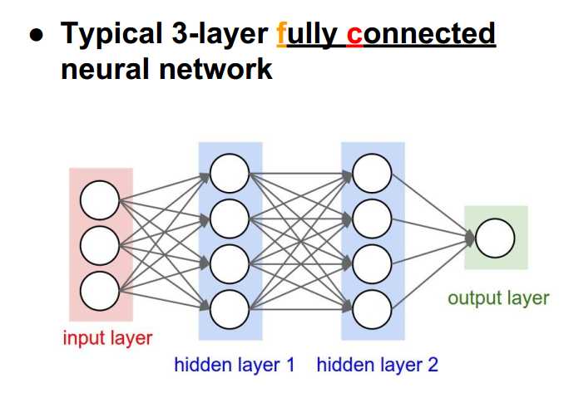
Fully Connected(Dense) Neural Network

Slide 4
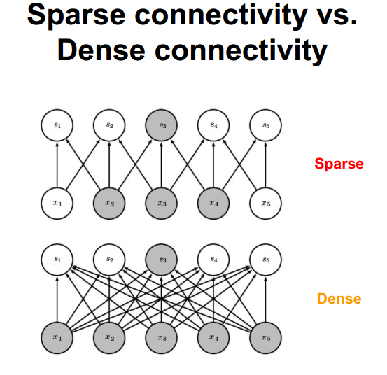

Slide 5
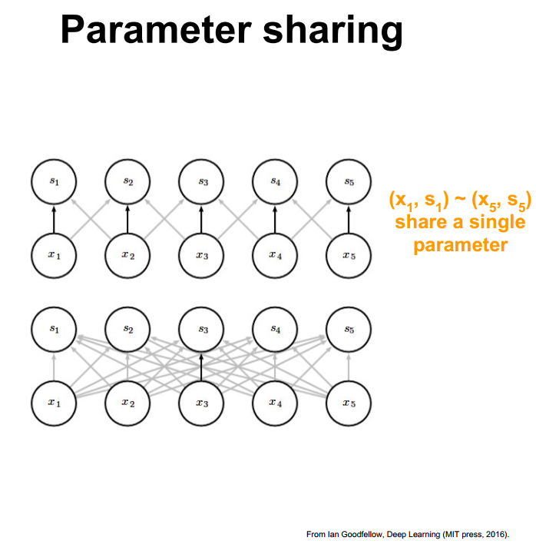

Slide 6
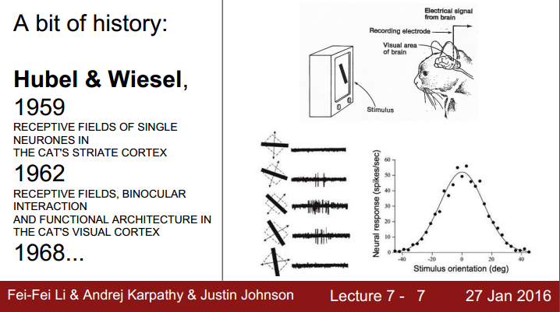

Slide 7
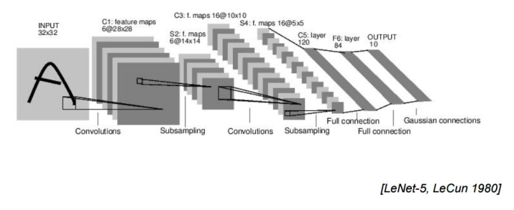

Slide 8
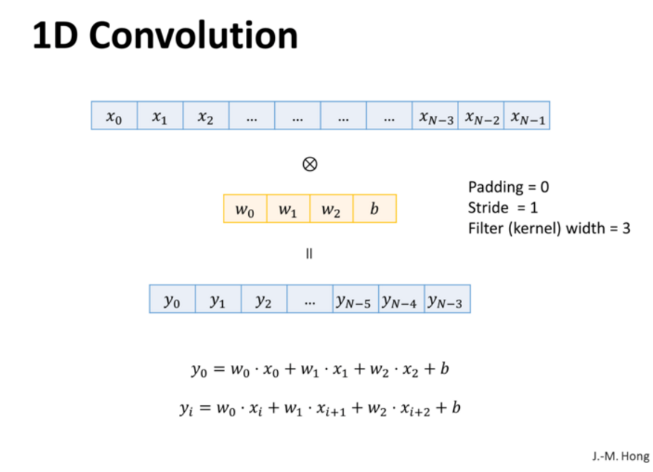
8-1. Convolutional Neural network, 홍정모 교수님

Slide 9
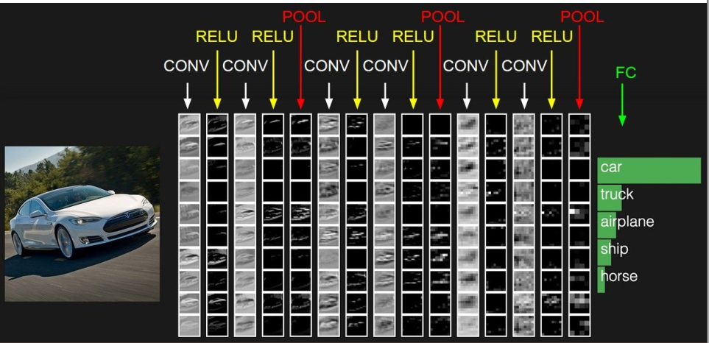
Preview

Slide 10
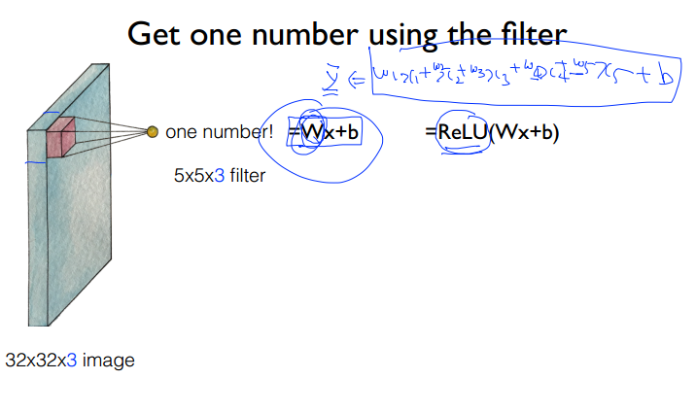
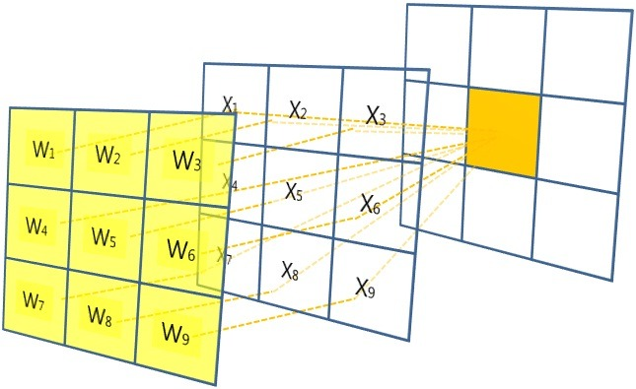
출처: 모두를 위한 머신러닝 시즌1, 김성훈 교수님

Slide 11
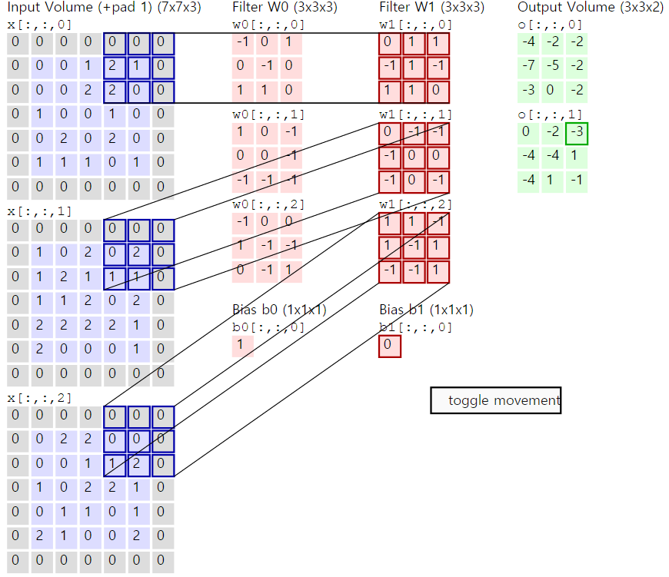
http://cs231n.github.io/convolutional-networks/

Slide 12
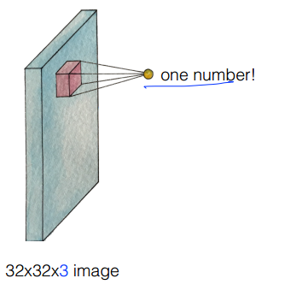
Let’s look at other areas with the same filter(w)
How many numbers can we get?
출처: 모두를 위한 머신러닝 시즌1, 김성훈 교수님

Slide 13
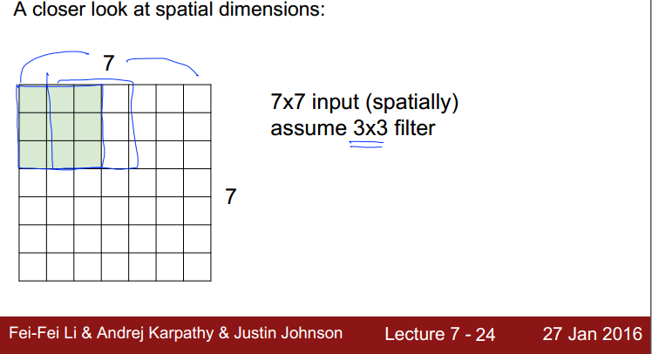

Slide 14
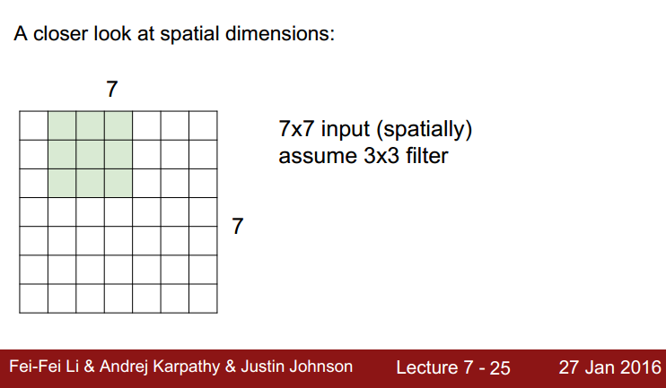

Slide 15
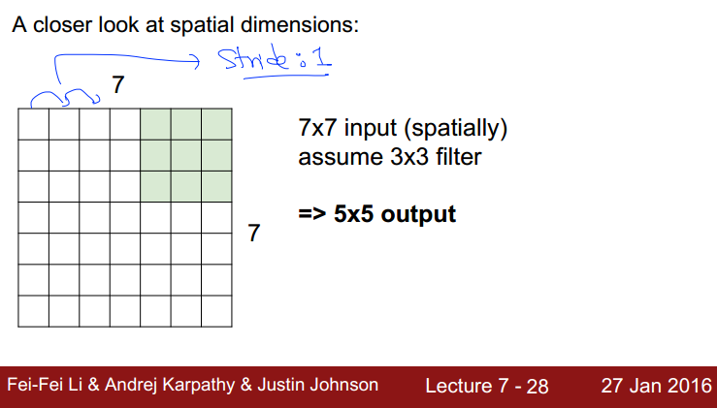

Slide 16
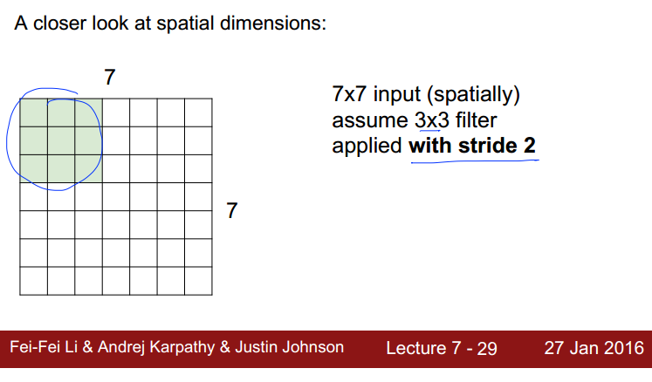

Slide 17
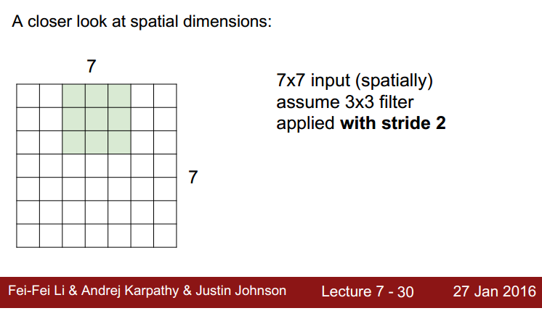

Slide 18
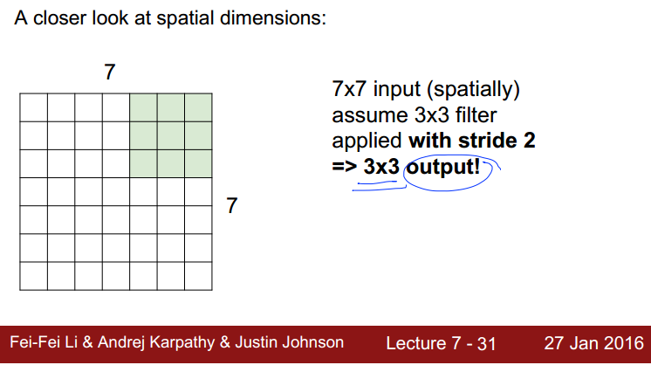

Slide 19
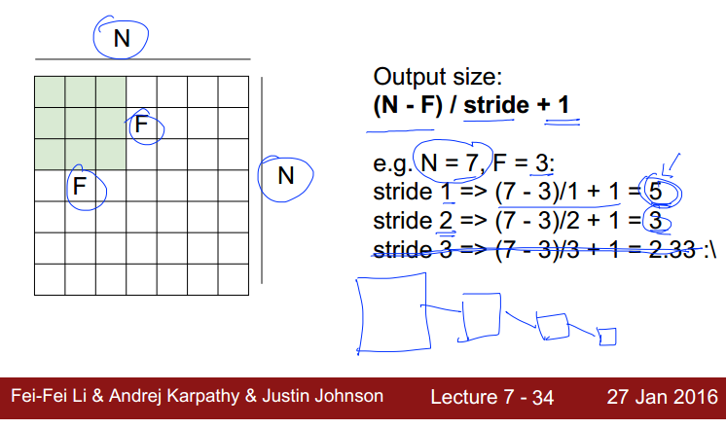

Slide 20
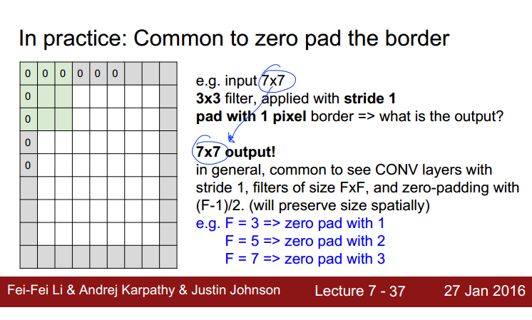

Slide 21
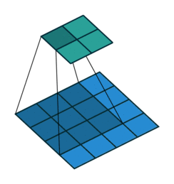
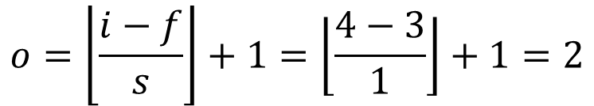
Output Image 크기 계산[1/2]
$$o=\left\lfloor \frac{i−f}{s}\right\rfloor +1=\left\lfloor \frac{4−3}{1}\right\rfloor +1=2$$
입력(i): 4x4
필터(f): 3x3
스트라이드(s): 1
https://github.com/vdumoulin/conv_arithmetic

Slide 22

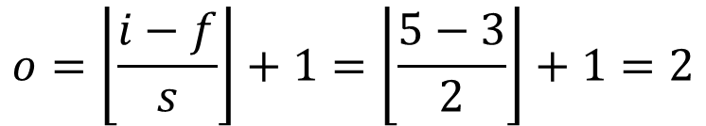
Output Image 크기 계산[2/2]
$$o=\left\lfloor \frac{i−f}{s}\right\rfloor +1=\left\lfloor \frac{5−3}{2}\right\rfloor +1=2$$
입력(i): 5x5
필터(f): 3x3
스트라이드(s): 2
https://github.com/vdumoulin/conv_arithmetic

Slide 23
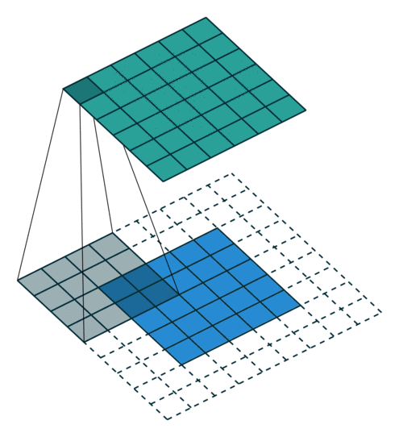
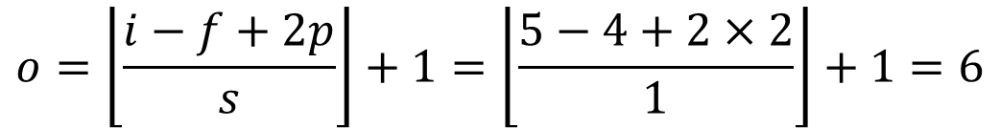
Padding 계산
$$o=\left\lfloor \frac{i−f+2p}{s}\right\rfloor +1=\left\lfloor \frac{5−4+2×2}{1}\right\rfloor +1=6$$
입력(i): 5x5
필터(f): 4x4
스트라이드(s): 1
https://github.com/vdumoulin/conv_arithmetic

Slide 24
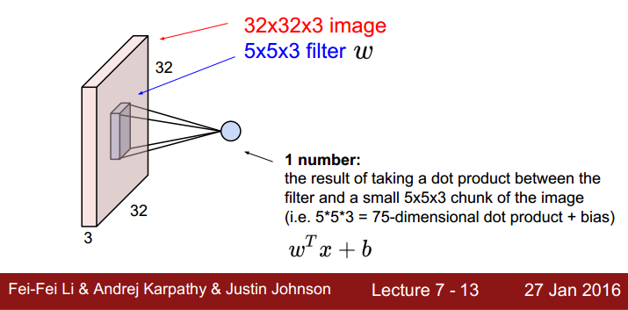
Activation Map 생성

Slide 25
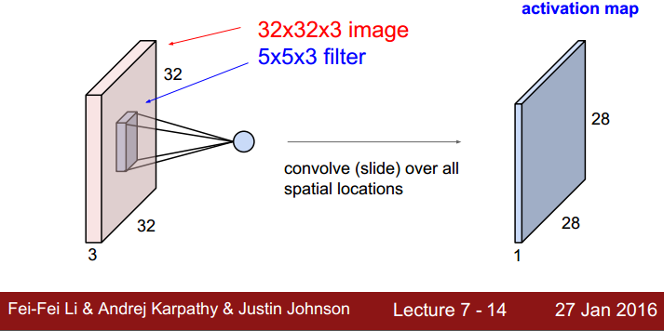

Slide 26
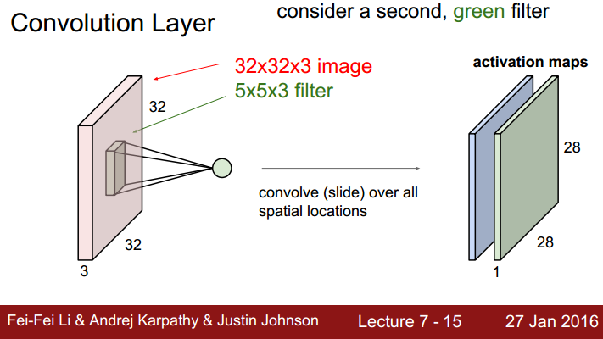

Slide 27
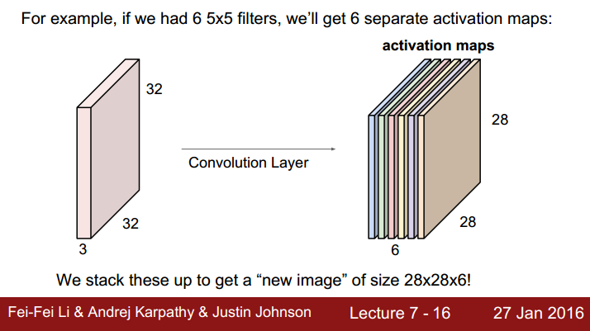

Slide 28
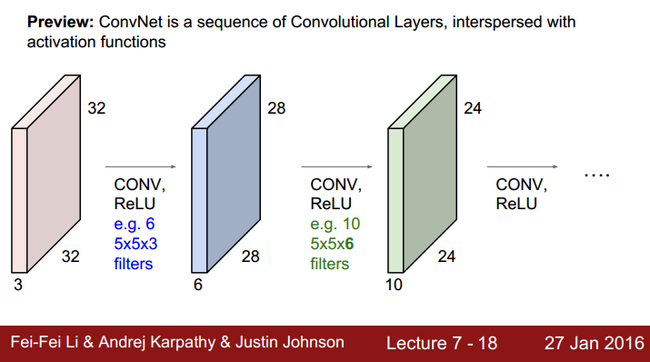

Slide 29
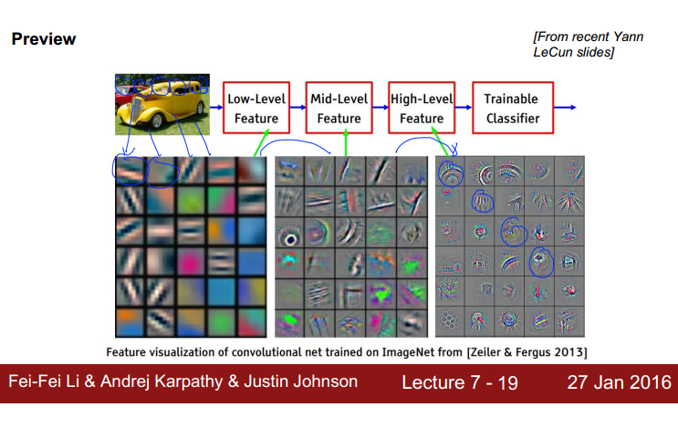

Slide 30
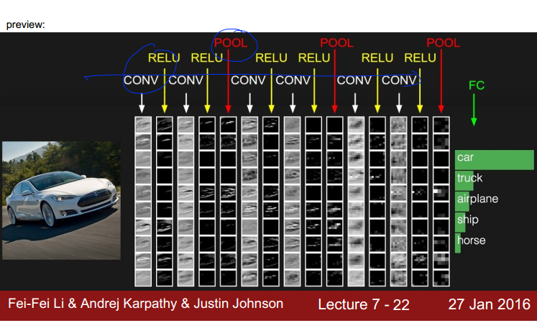

Slide 31
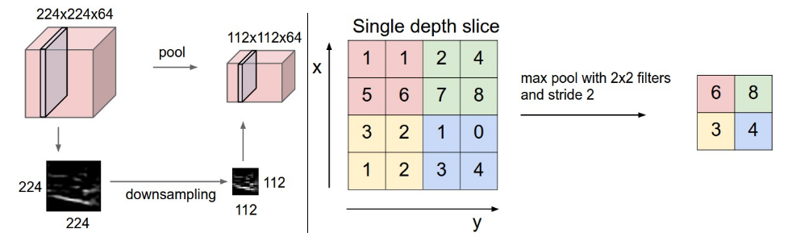
Polling (subsampling)
가중치를 곱하거나 바이어스를 더하는 것이 없음
입력 맵에서 읽은 데이터를 재 가공함
보통 풀링 크기와 스트라이드 크기가 같음

Slide 32
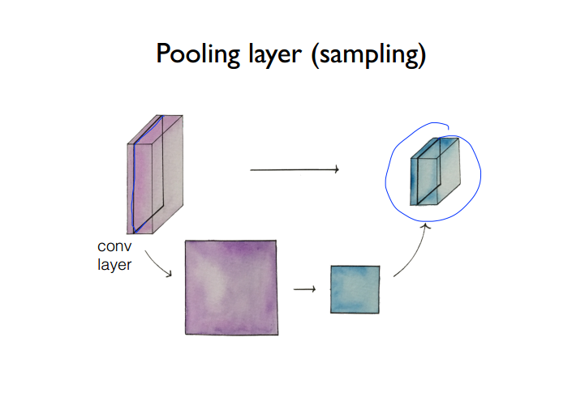

Slide 33
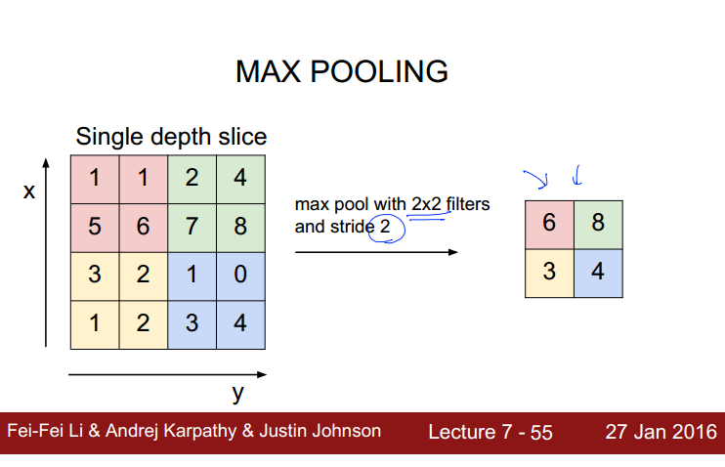

Slide 34
Fully Connected Layer (FC Layer)
Contains neurons that connect to the entire input volume, as in ordinary Neural Networks

Slide 35
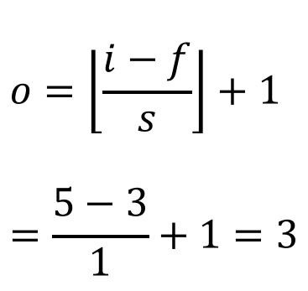
평균 풀링
$$o=\left\lfloor \frac{i−f}{s}\right\rfloor +1 \\ =\frac{5−3}{1}+1=3$$
Notes:
y 햇: h, f 등으로 쓰기도 함.

Slide 36
맥스 풀링
$$o=\left\lfloor \frac{i−f}{s}\right\rfloor +1 \\ =\frac{5−3}{1}+1=3$$
Notes:
y 햇: h, f 등으로 쓰기도 함.

Slide 37
MNIST 실습

Slide 38
구현할 CNN 구조
코드 위치:
일반코드: https://github.com/leejaymin/TensorFlowLecture/blob/master/5.CNN/CNNforMNIST.ipynb
TensorBoard 적용: https://github.com/leejaymin/TensorFlowLecture/blob/master/5.CNN/CNNforMNIST-tensorboard.ipynb
FC(2048,625)
Input(28x28)
C(28x28)
POOL(14x14)
C(14x14)
POOL(7x7)
C(7x7)
POOL(4x4)
FC(625,10)
0
....
9
3x3x1
..
3x3x1
3x3x1
Activation Map 32
Activation Map 32
Activation Map 64
Activation Map 64
Activation Map 128
Activation Map 128

Slide 39


Parameter updates

Slide 40
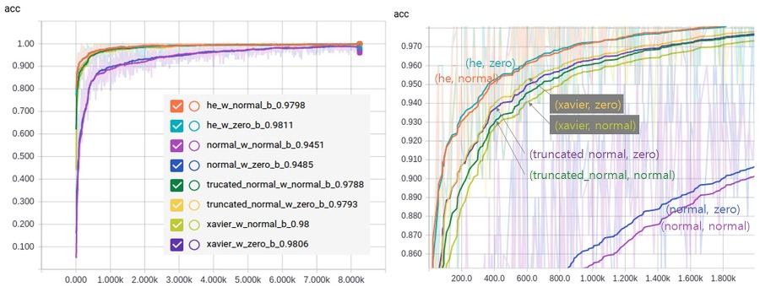
Weight Initialization
Truncated normal initialization 사용

Slide 41
구현 내용
기본적인 MLP 구현
One hidden layer
Testing accuracy: ~92%
5-layer MLP with ReLU
ReLU, Sigmoid, Softmax
Testing accuracy: ~97%
Pre-training and Dropout
Xavier init. and new regularization
Testing accuracy: ~99%
Convolutional Neural Network
Testing accuracy: 100%

Slide 42
Break down the CNN in more detail
Input: 28x28x1, memory: 784, weights: 0
Conv-32: 28x28x32, memory: 25k , weights: 3*3*1*32 = 288
Pool2- 14x14x32 , memory: 6k , weights: 0
Conv-64: 14x14x64 , memory: 12k , weights: 3*3*1*64 = 576
Pool2: 7x7x64 , memory: 3k , weights: 0
Conv-128: 7x7x128 , memory: 6k , weights: 3*3*1*128 = 1,152
Pool2: 4x4x128 , memory: 2k , weights: 0
FC: 1x1x2048 , memory: 2k , weights: 4*4*128*2048 = 4,194,304
FC: 1x1x10 , memory: 10 , weights: 2048*10 = 20,480
Total memory: 56.794k * 4bytes ~=227.176k (only forward per a image)
Total params: 4,216,800 (4M) parameters

Slide 43
구현 내용
기본적인 MLP 구현
One hidden layer
Testing accuracy: ~92%
Memory: (784 + (784*256)+10) * 4bytes = 805,992 (804k)
Params: [256,28x28+1] + [10,256+1]=203,530 (203k) parameters
Convolutional Neural Network
Testing accuracy: 100%
Total memory: 56.794k * 4bytes ~=227.176k (only forward per a image)
Total params: 4,216,800 (4M) parameters
Accuracy 8% 향상 vs. memory 5배 사용 + 엄청난 연산

Slide 44
속도
Processor | FLOPS | 속도
I7-4790k | 34 GFLOPS | 105분 31초, 1x
GTX-745 | 793 GFLOPS | 36분 30초, 2.89x
AWS EC2, K520 | 2448 *2 GFLOPS | 22분 4초, 4.78x
GTX-970 | 3494 GFLOPS | 9분 10초, 11.5x
GTX-1080 | 8990 TFLOPS | 5분 27초, 19.3x

Slide 45
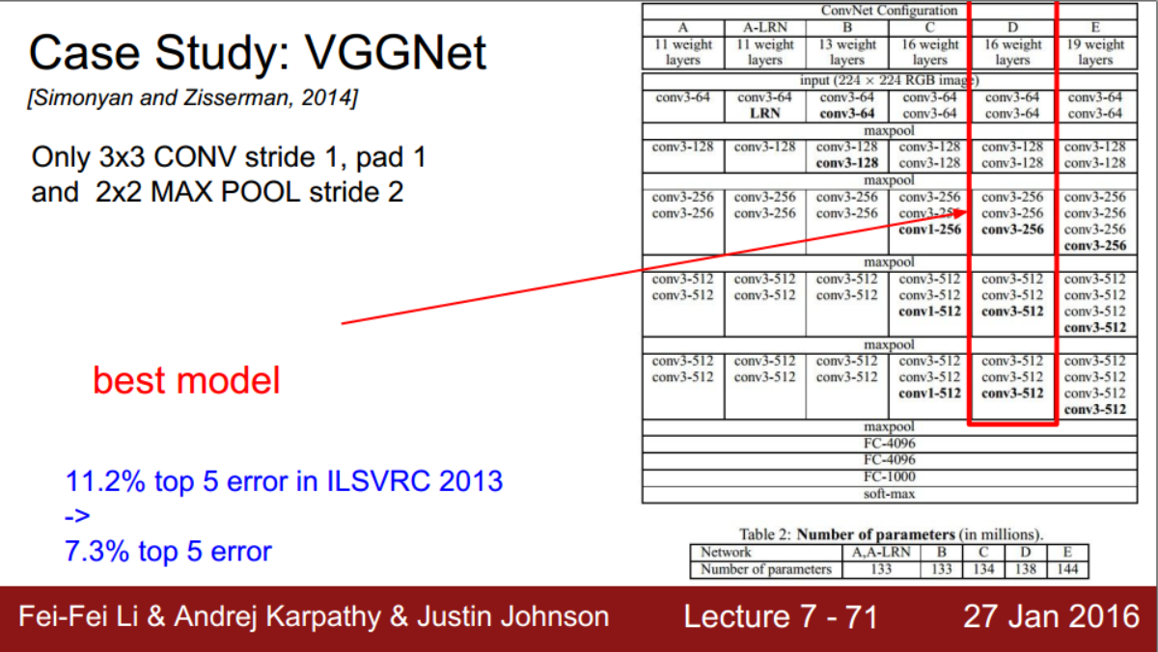
VGGNet 16
ImageNet 2013 우승 모델

Slide 46
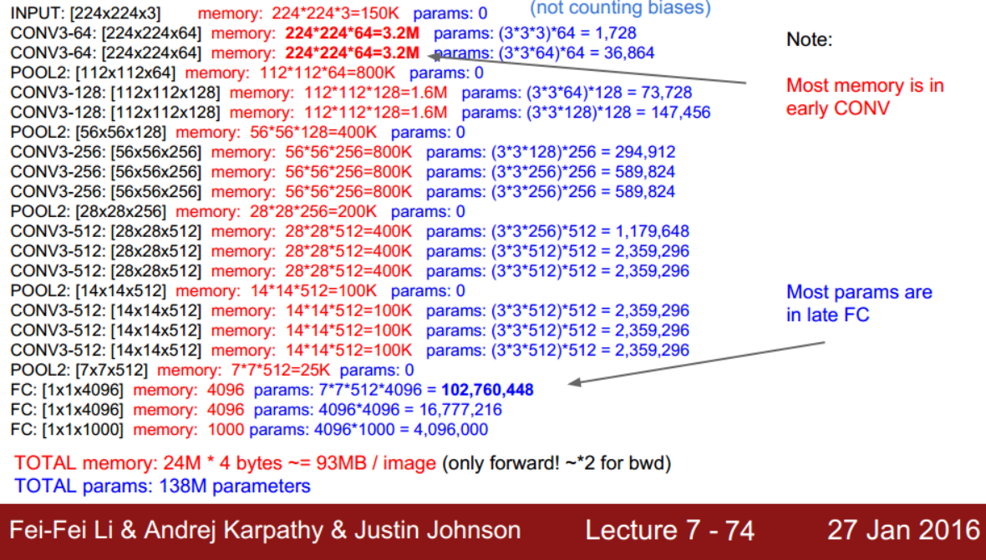

Slide 47
Wrap-up
Nuts and Bolts of Applying Deep Learning (Andrew Ng), NIPS 2016
How do I become machine learning researcher?
How do I have my own idea?
Read a lot of papers (20~30) and then replicate results
Human brain is remarkable device
This is incredibly reliable process
Dig into the dirty work:
cleaning data, replicating results, or hacking the GPU.
Almost Ph.D Students want to change the world. If you work on AI, what you do have to actually impact to a lot of people

